Slide 1
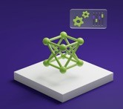
Object Detection & Tennis Player Trajectory Prediction
Name: Xujia Qin
Affiliation: Khoury School of Computer Science, Northeastern University
Date: 06/17/2025

Slide 2
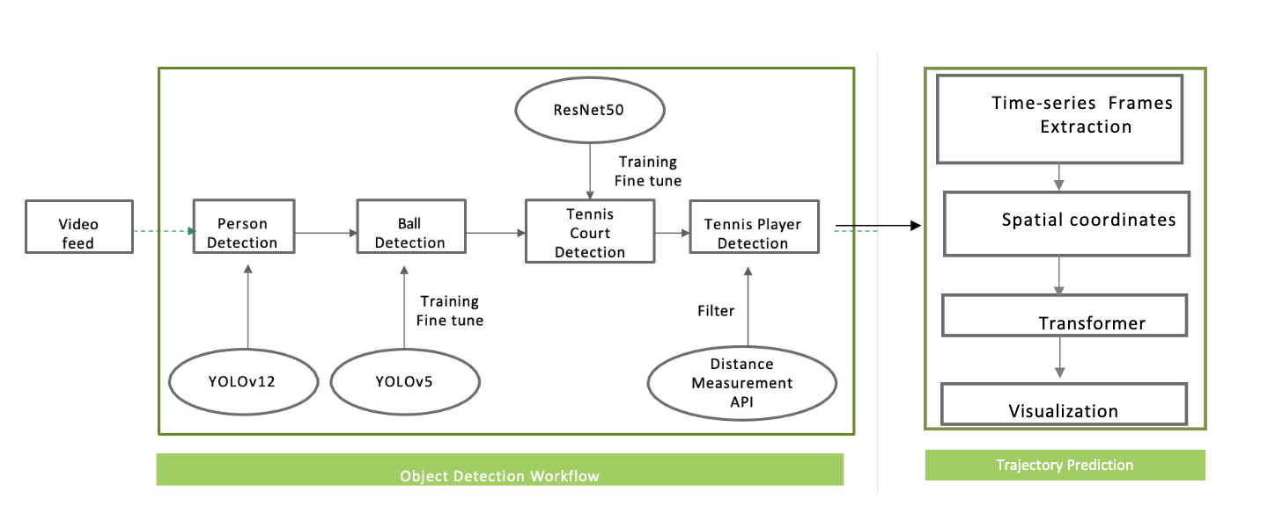
Solution Architecture Tennis Player and Balls Detection Trajectory Prediction

Slide 3
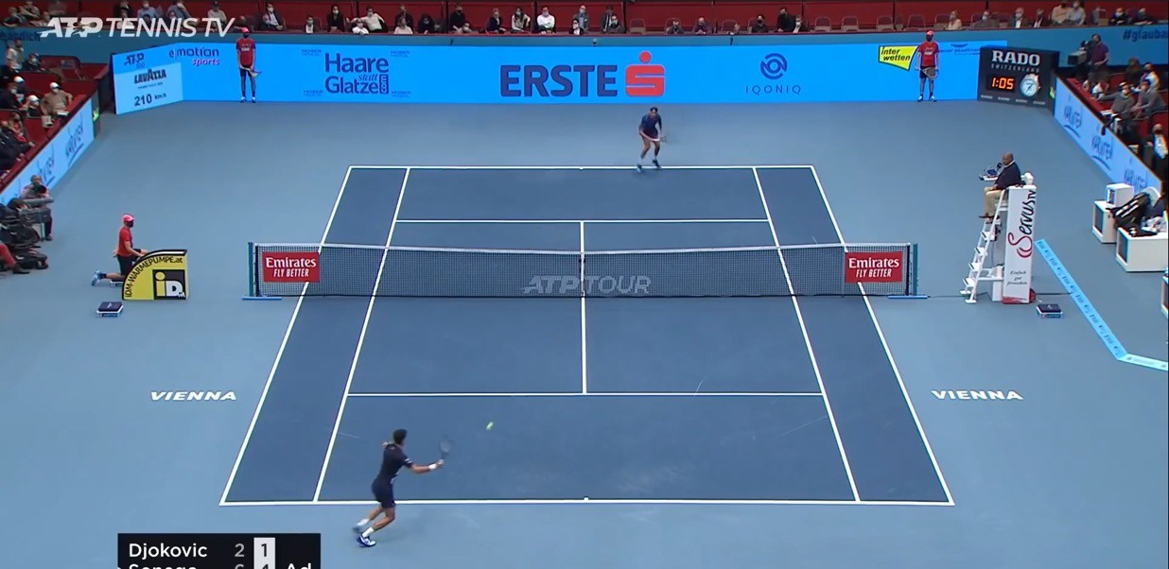
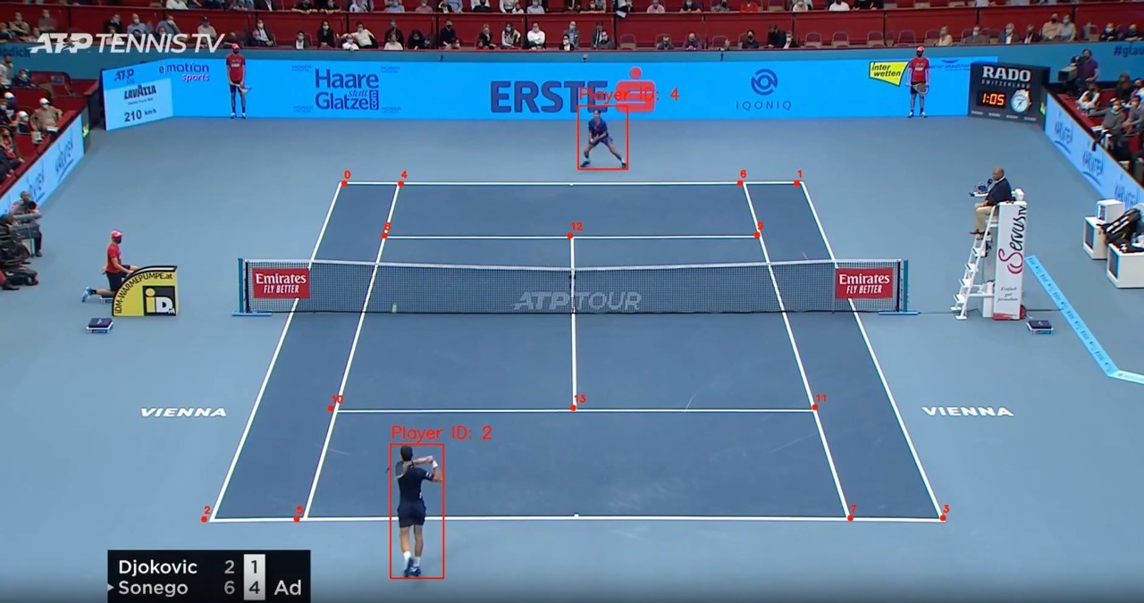
Overview of the System
Tennis Player and Balls Detection
Key Components:
Object Detection: Using YOLO for detecting players and the ball.
Court Detection: Utilizing ResNet to identify 14 keypoints of the tennis court.
Tracking Attributes: Real-time tracking of player and ball positions.
Player Trajectory Prediction: Leveraging Transformer-based models to predict future player movement based on spatiotemporal features.
Visualization: Overlaying detection, tracking, and prediction results on picture frames for intuitive analysis.

Slide 4
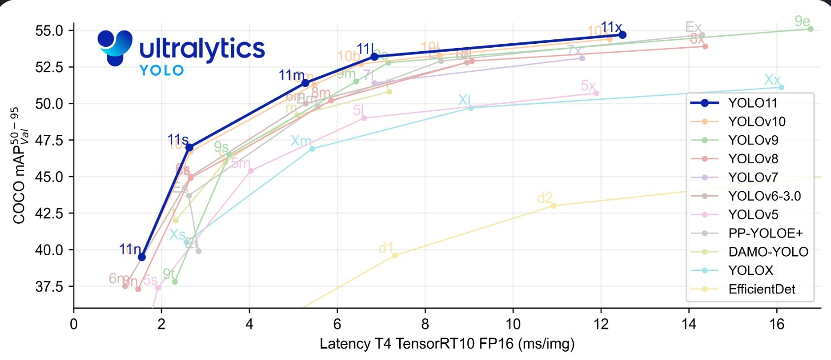
Implementation
YOLO for Object Detection
YOLOv12:
Advanced architecture for high-speed.
Suitable for general object detection and robust under dynamic environments.
YOLOv5:
Best for detecting small objects like tennis balls due to multi-scale features.
Chosen for ball detection due to its robustness and high accuracy.
Mean Average Precision (mAP)
link

Slide 5
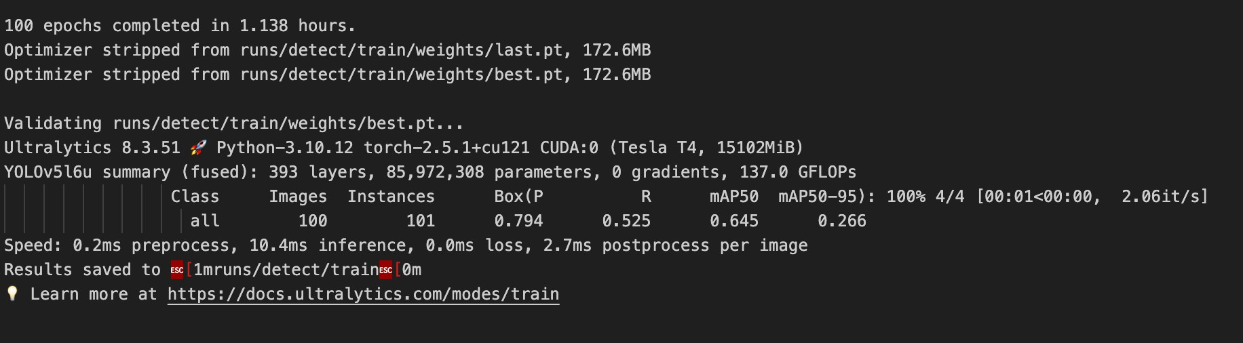
Implementation
Training YOLOV5 and Results
Dataset:
Training set: 428 images
Validation set: 100 images
Test set: 50 images
Fine-tune YOLOV5 for 100 epochs
Results:
mAP50: 0.645 (mean average precision at 50% IoU threshold)
mAP50-95: 0.266 (mean average precision at multiple IoU thresholds between 50% and 95%)
Precision: 0.794 (predicted positive instances were actually correct)
Recall: 0.525 (how many of the true positive instances were correctly predicted)
Speed:
Preprocess: 0.2ms per image
Inference: 10.4ms per image
Postprocess: 2.7ms per image

Slide 6
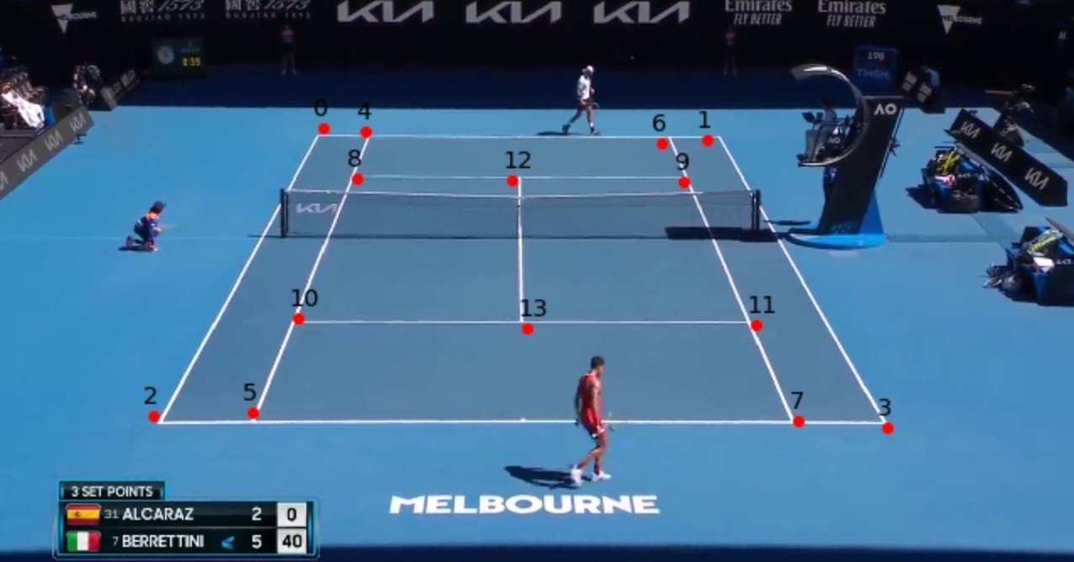
Implementation
TennisCourtDetector and Court Keypoint Detection
TennisCourtDetector:
Deep learning model to detect 14 keypoints of the tennis court.
Keypoints include baselines, service lines, net intersections, etc.
Reference: link
Post-Processing:
Keypoint refinement using classical methods (line detection).
Homography-based correction for geometric accuracy.

Slide 7
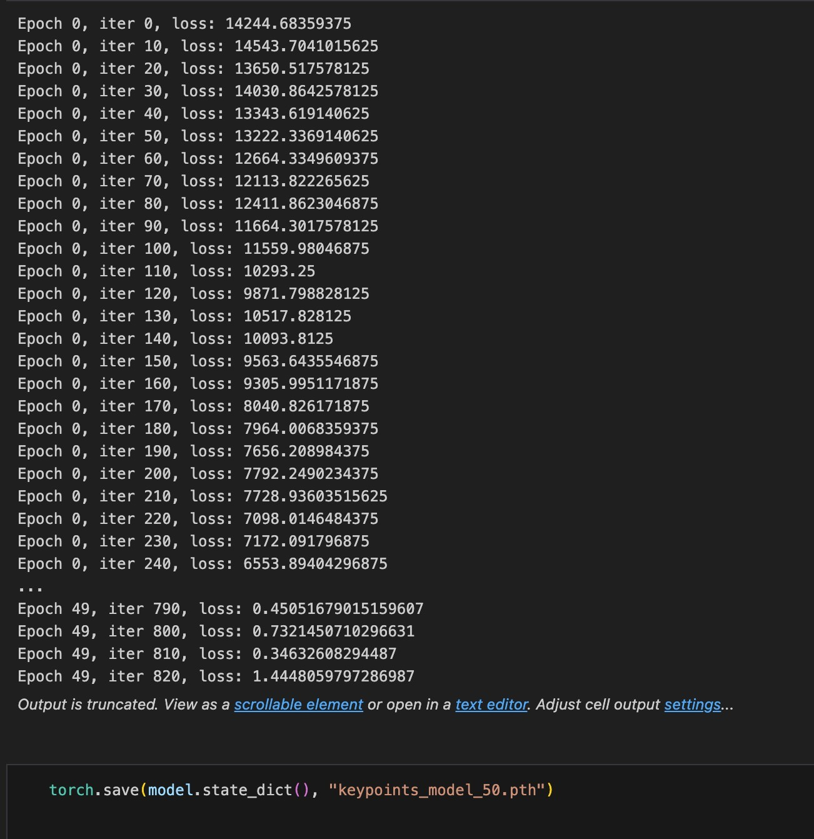
Implementation
Training ResNet50 Model and Results
Tennis Court Key Points
14 key points for detecting tennis court boundaries
Dataset:
8841 images link
75% used for training 25% used for validation
Image resolution: 1280 x 720, resized to 244 x 244 pixels
Normalization
ResNet Backbone:
Used for feature extraction in image classification
Fine-tuning:
Fine-tune ResNet-50 for 50 epochs
As iterations increase, the loss decreases
Save the model in .pth format for further use

Slide 8
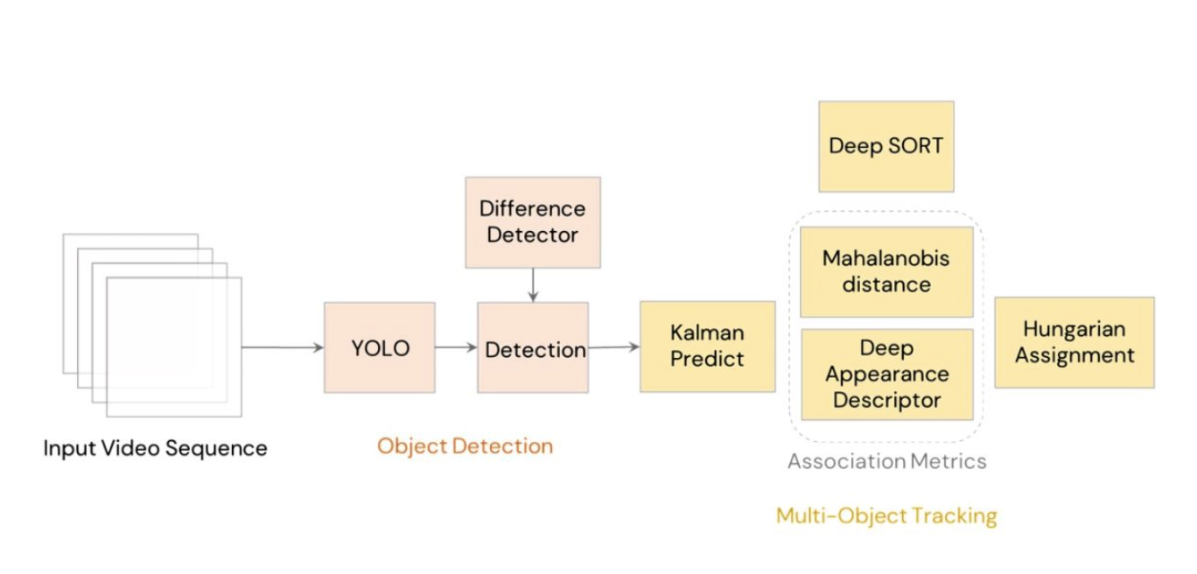
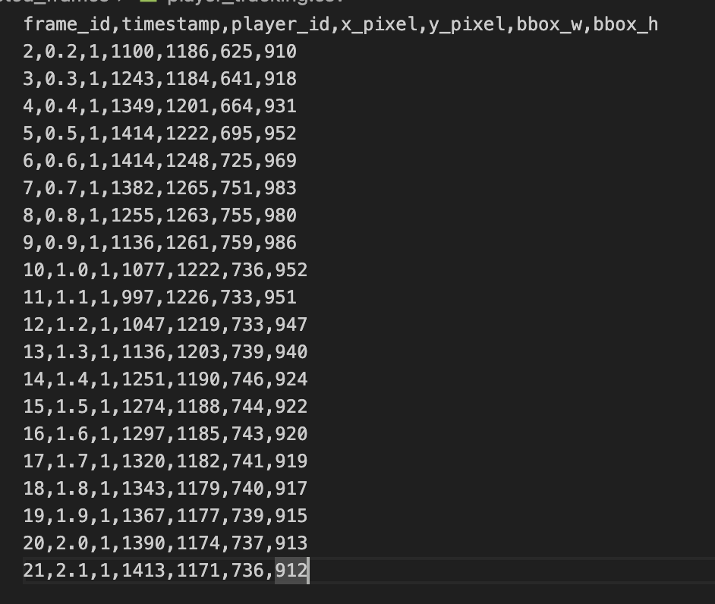
Implementation
Attributes for Trajectory Prediction
Convert Video Frames into Bounding Boxes Positions: DeepSort (Deep Online And Real Time Tracking)
Object Detector (external): Feeds bounding boxes into DeepSORT (YOLO).
Kalman Filter: Predicts motion and future positions of objects.
Appearance Feature Extractor: CNN generates a 128-D feature vector for each detection.
Hungarian Algorithm: Matches detections to existing tracks using motion + appearance.
Track Management: Initializes, updates, and removes object tracks over time.
link
Notes:
https://www.ikomia.ai/blog/deep-sort-object-tracking-guide

Slide 9
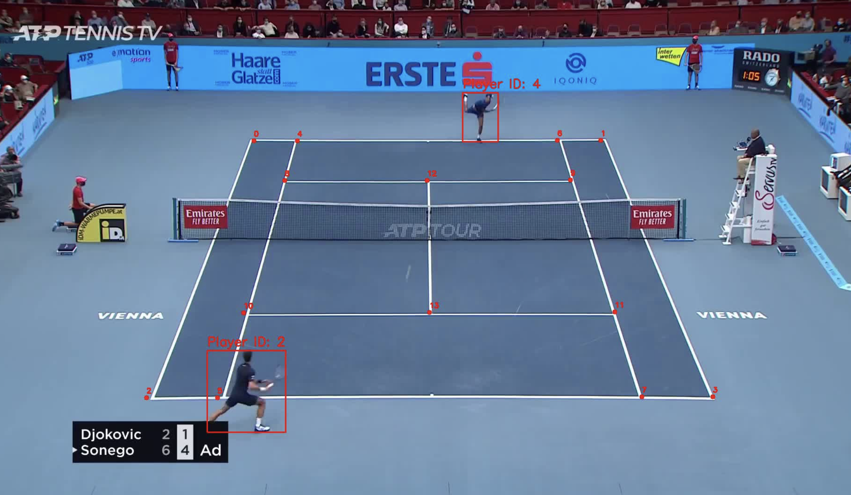
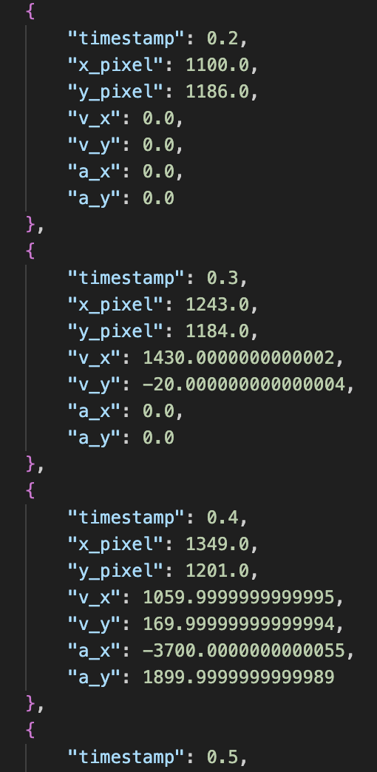
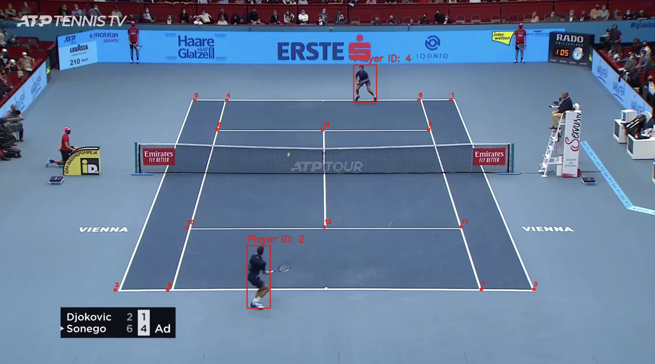
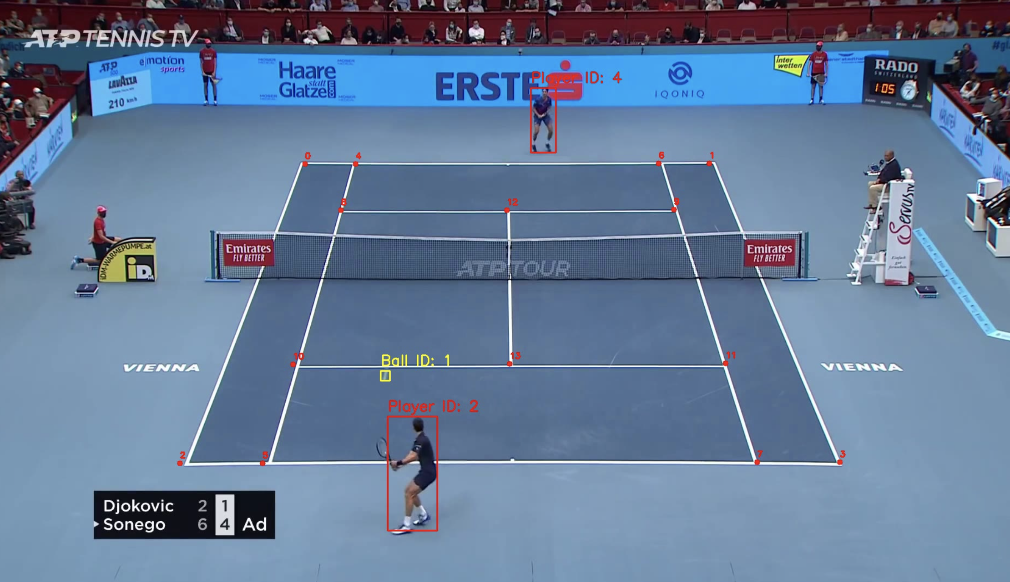
Implementation
Attributes for Trajectory Prediction
Convert Bounding Boxes Position into Time Series Spatial Features: Customized APIs
Player Position Coordinates: 𝑥𝑡 , 𝑦𝑡 — 2D court coordinates at each timestamp.
Velocity Vector: 𝑣𝑥 , 𝑣𝑦 — change in position over time, indicating speed and direction.
Acceleration Vector: 𝑎𝑥 , 𝑎𝑦​ — change in velocity, capturing sudden starts/stops or direction changes.
link

Slide 10
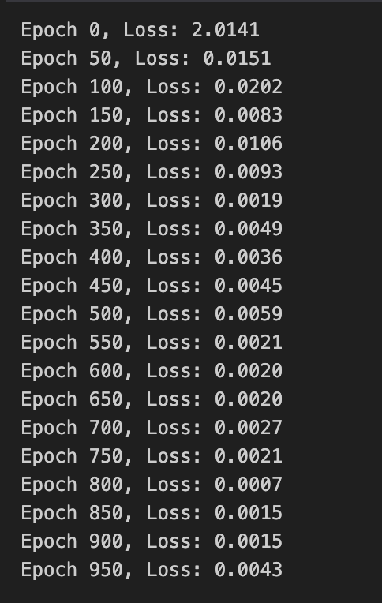
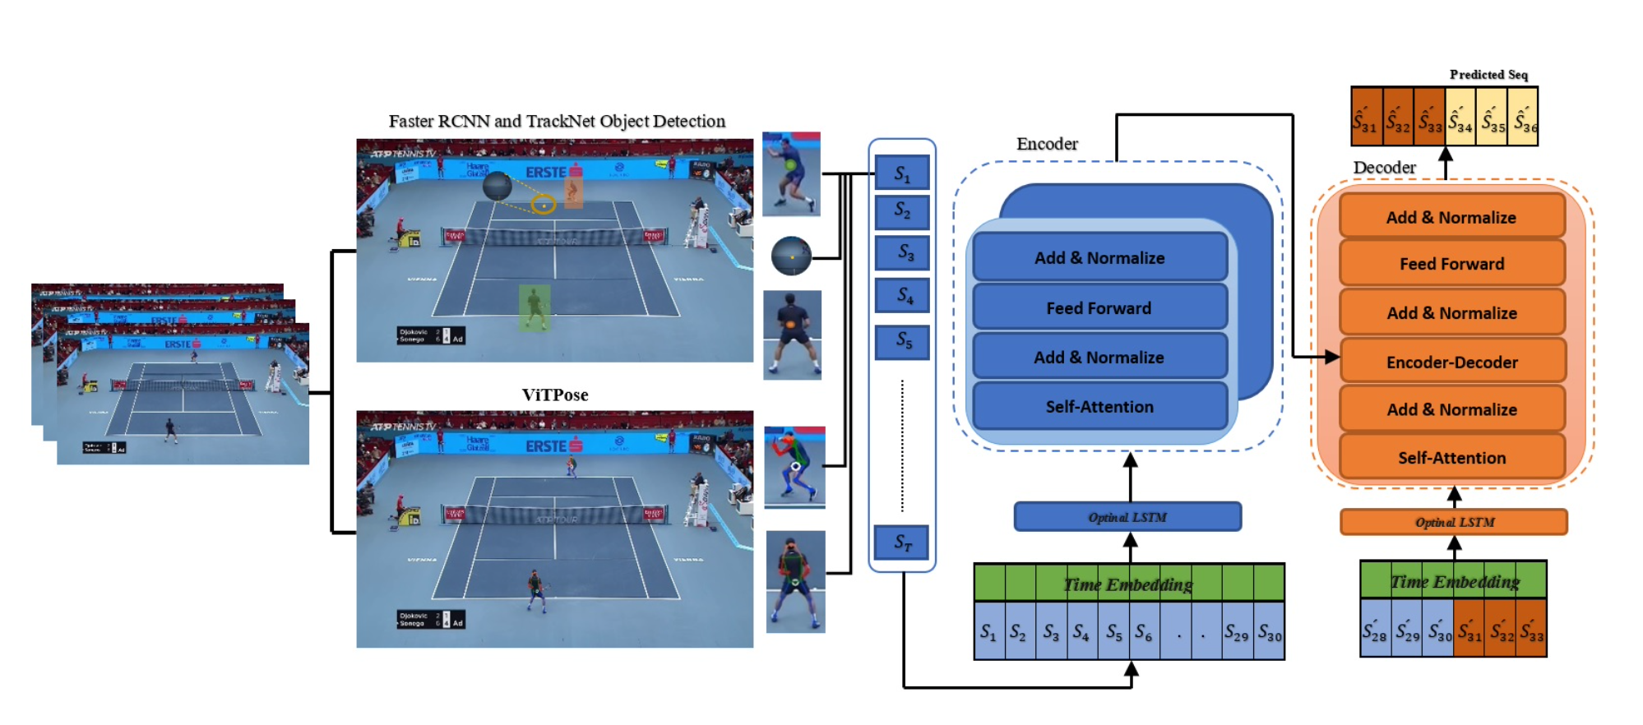
Implementation
Customized Model for Trajectory Prediction
Model Internals:
Input
LSTM layer: processes input to capture temporal dependencies and patterns.
Time2Vector: produces a 10-dimensional time embedding vector per time step.
Concatenation combines LSTM output features and Time2Vector time features along the feature dimension.
Multi-Head Self-Attention: Allows the model to weigh different time steps adaptively.
Multi-Head Cross-Attention: Performs cross-attention between the current output and encoder representations.
Dense layer → Dropout → Residual Added
TimeDistributed Output

Slide 11
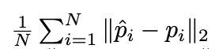
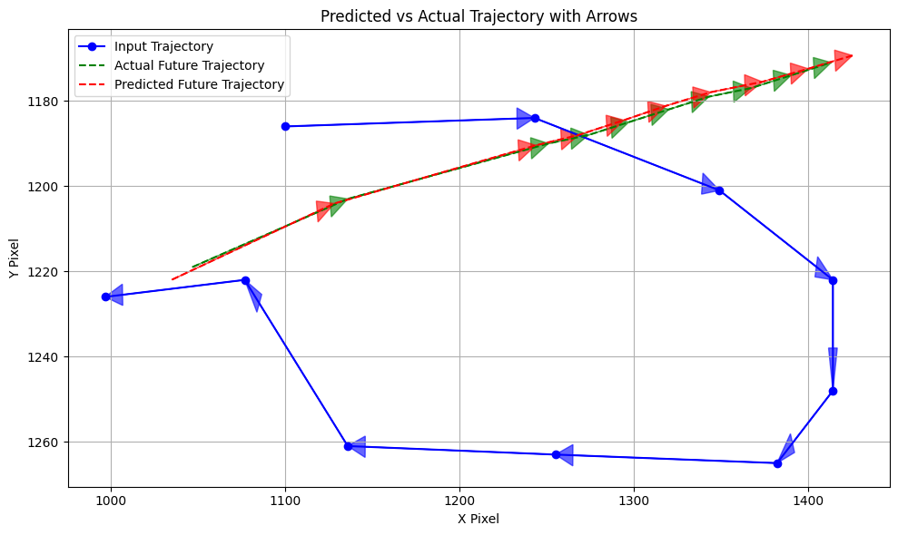
Implementation
Evaluation (100 ms, 10fps)
Evaluation:
Average Displacement Error (ADE): 2.4428
Final Displacement Error (FDE): 2.9598

Slide 12
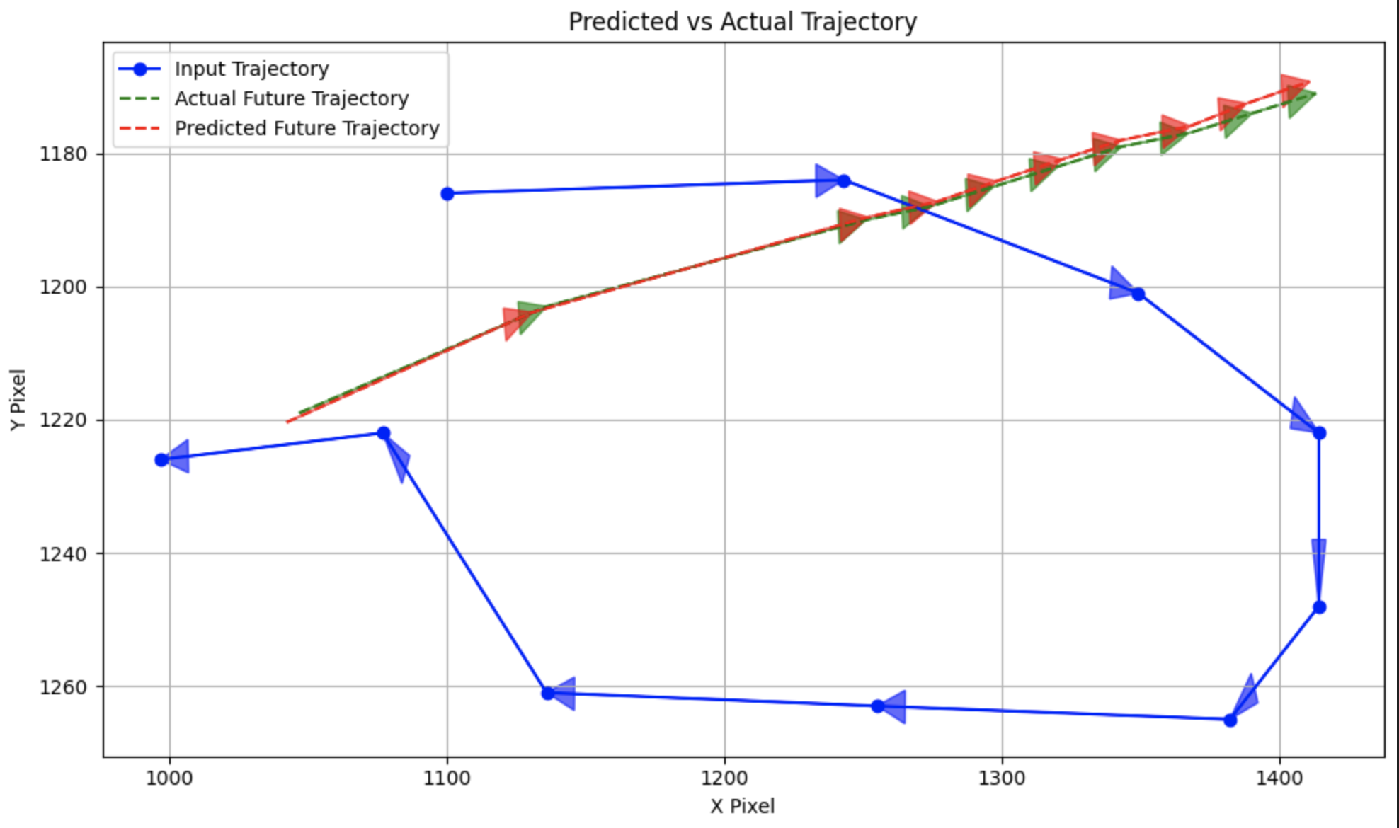
Implementation
Evaluation (200 ms, 10fps)
Evaluation:
Average Displacement Error (ADE): 6.7906
Final Displacement Error (FDE): 12.3029

Slide 13
Conclusion
Future Direction
The system achieves strong short-term accuracy (ADE ≈ 2.84), but long-term prediction shows higher
displacement error (FDE ≈ 12.30), reflecting the complexity of extended motion forecasting. To improve long-horizon prediction, future work could include:
Incorporating richer spatial features (e.g.,distance to net or baseline)
Leveraging player pose estimation (e.g., ViT-Pose)
Integrating game-state context (e.g., shot type, score)
Applying hybrid physics-informed models to improve temporal coherence

Slide 14
References
V. Yastrebksv, et al., “TrackNet: Tennis Court Keypoint Detection in Broadcast Videos,” in *Proc. of the IEEE Conf. on Computer Vision and Pattern Recognition (CVPR)*, 2018.
S. Yun, J. Lee, and B. Kwak, ``TennisFormer: Transformer-Based Tennis Trajectory Forecasting with Spatio-Temporal Context,'' {Proceedings of the IEEE/CVF Conference on Computer Vision and Pattern Recognition (CVPR), 2021.
A. Bochkovskiy, et al., “YOLOv4: Optimal Speed and Accuracy of Object Detection,” in *Proc. of the IEEE/CVF Conf. on Computer Vision and Pattern Recognition (CVPR)*, 2020.
G. Jocher, “YOLOv5 by Ultralytics,” GitHub Repository, 2020. [Online]. Available: https://github.com/ultralytics/yolov5. Accessed: Apr. 23, 2025.
G. Jocher et al., “YOLOv8: Next-Generation Real-Time Object Detection,” GitHub Repository, 2023. [Online]. Available: https://github.com/ultralytics/ultralytics. Accessed: Apr. 23, 2025.
X. Chen et al., “PP-YOLOE: An Evolved Version of YOLO,” *arXiv preprint arXiv:2203.16250*, 2023.
Joseph Redmon, Santosh Divvala, Ross Girshick, and Ali Farhadi. “You Only Look Once: Unified, Real-Time Object Detection.” *Proceedings of the IEEE Conference on Computer Vision and Pattern Recognition (CVPR)*, 2016. [Online]. Available: http://pjreddie.com/yolo/
D. Nguyen, et al., “Deep Learning for Sports Video Analysis: A Survey,” *IEEE Transactions on Image Processing*, 2020.
M. Shrestha and W. Shih, “Tennis Ball Tracking Using Convolutional Neural Networks,” *IEEE Transactions on Computer Vision*, 2020.
A. Karpathy, et al., “Sports-1M Dataset and Model for Real-Time Sports Video Analysis,” in *Proc. of the IEEE Conf. on Computer Vision and Pattern Recognition (CVPR)*, 2016.
L. Zhang, et al., “Real-Time Object Detection and Tracking in Sports Videos,” 2020.

